Slide 1

Payroll Management
Kumar Sadhu

Slide 2
Table of contents
Introduction
Technologies
Django framework
AWS Elastic Beanstalk
Features of web application
Admin
Employee
Salary details
Time sheet
Deployment into AWS Elastic Beanstalk
Monitoring and Logs
Results

Slide 3
” The key is in not spending time, but in investing it ” Stephen R Covey

Slide 4
Introduction
Name of the application : Samayam Application
It simplifies the process of record maintenance of employee's information and their pay slips and Timesheets in an organization.
Directly salary computation is done physically, it set aside such an extensive amount of effort to make payout all things considered.
Minimizes the manual checking of each daily time record of the employee.

Slide 5
Technologies
Frame Works : Django Frame Work
Languages : python, HTML, CSS, Java script, Jquery.
AWS Elastic Beanstalk.

Slide 6
Why Django Framework?
Django is Ridiculously fast, Fully loaded, Reassuringly secure, Exceedingly scalable, Incredibly versatile.
It is free and also open-source software where web development concepts in a matter of hours.
It follows MVC (Model-View-Controller) core architecture.
Avoid common security issues like clickjacking, cross-site scripting, and SQL injection.

Slide 7
Why AWS Elastic Beanstalk?
AWS Elastic Beanstalk is a service used to deploy and scale web applications.
Elastic Beanstalk automatically handles the deployment, from capacity provisioning, load balancing, auto-scaling to application health monitoring.
Highly scalable
Fast and Simple to begin
Offers Quick Deployment.
Supports multi-tenant architecture.
Simplifies operations.
Cost–efficient.

Slide 8
Features of Web Application
Users or employee’s –
Leave Management
Pay-slips
Manage Profile
Monthly statements
Admin or HR –
Monitoring Leave Management
Manage Employee Profile.

Slide 9
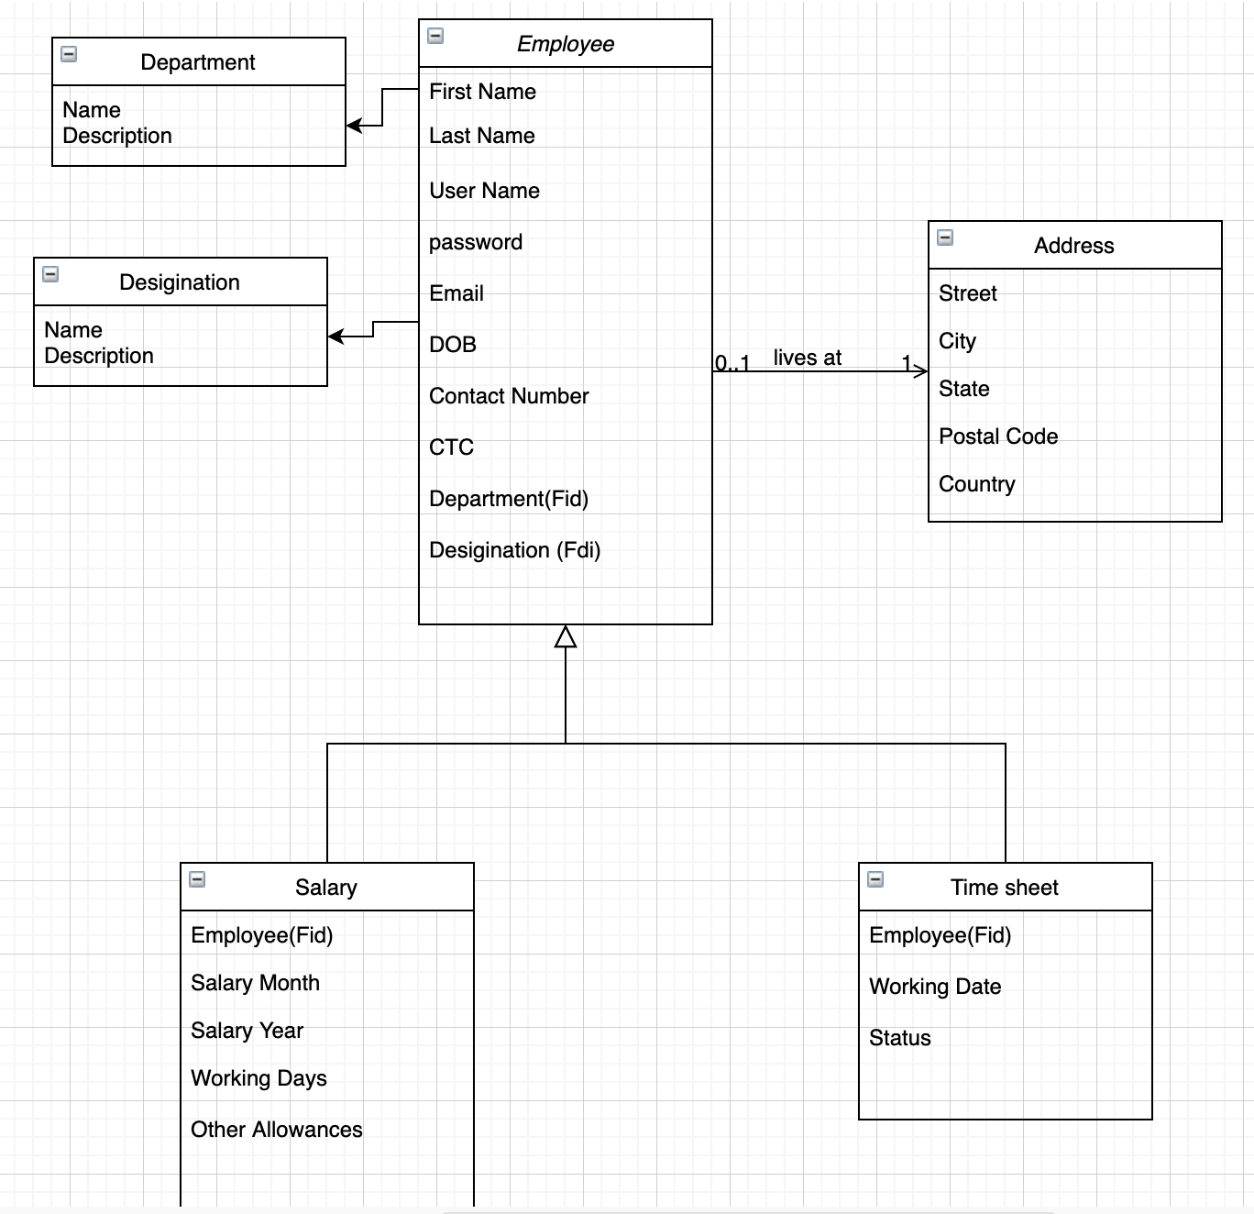
Models – Class Diagram

Slide 10
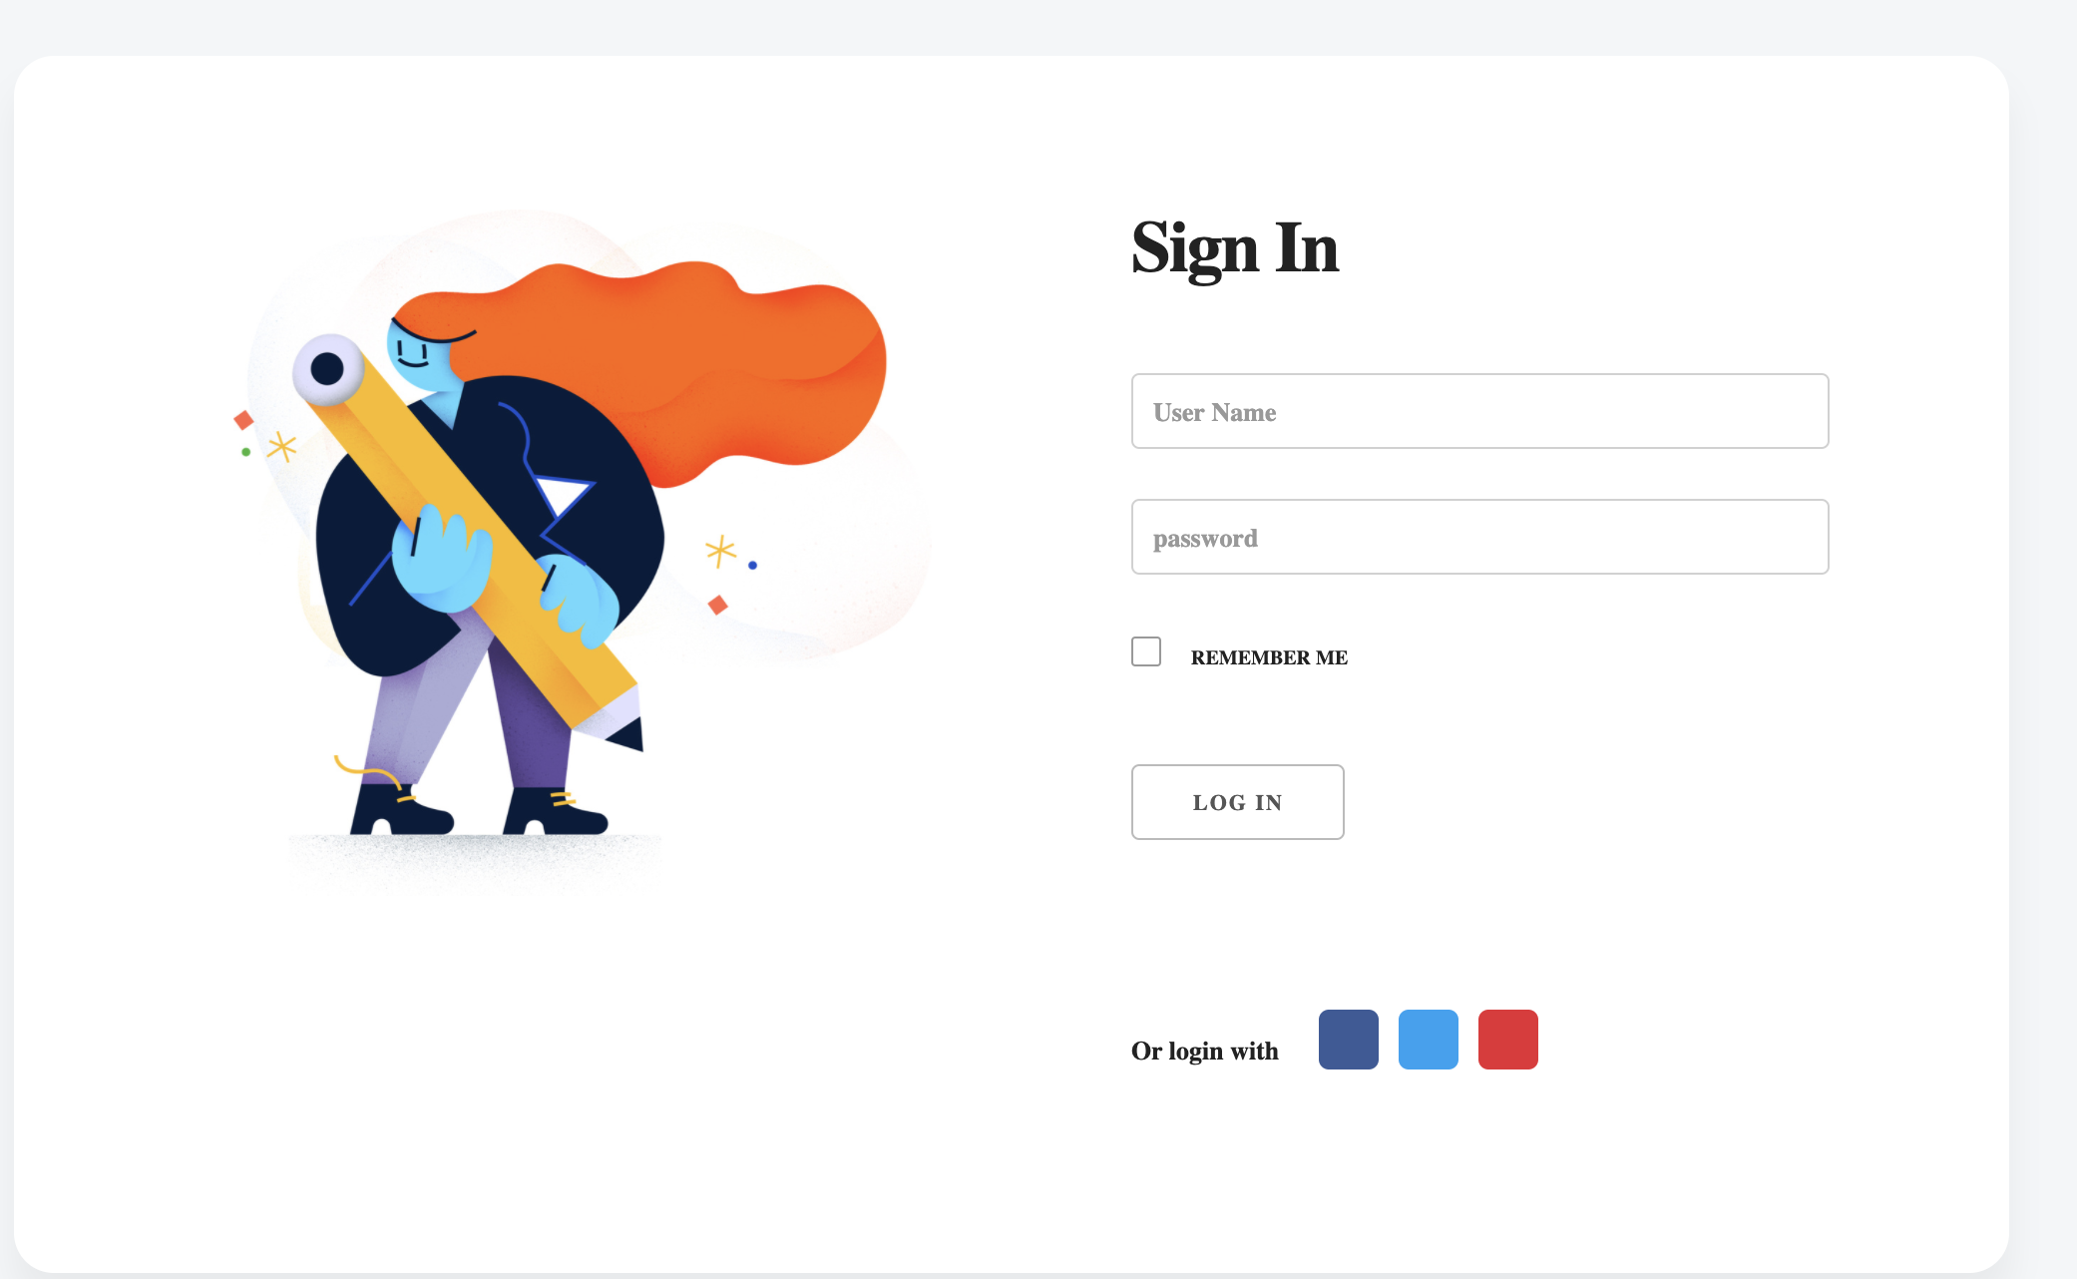
Login page
Admin creates username and password for all the employees

Slide 11
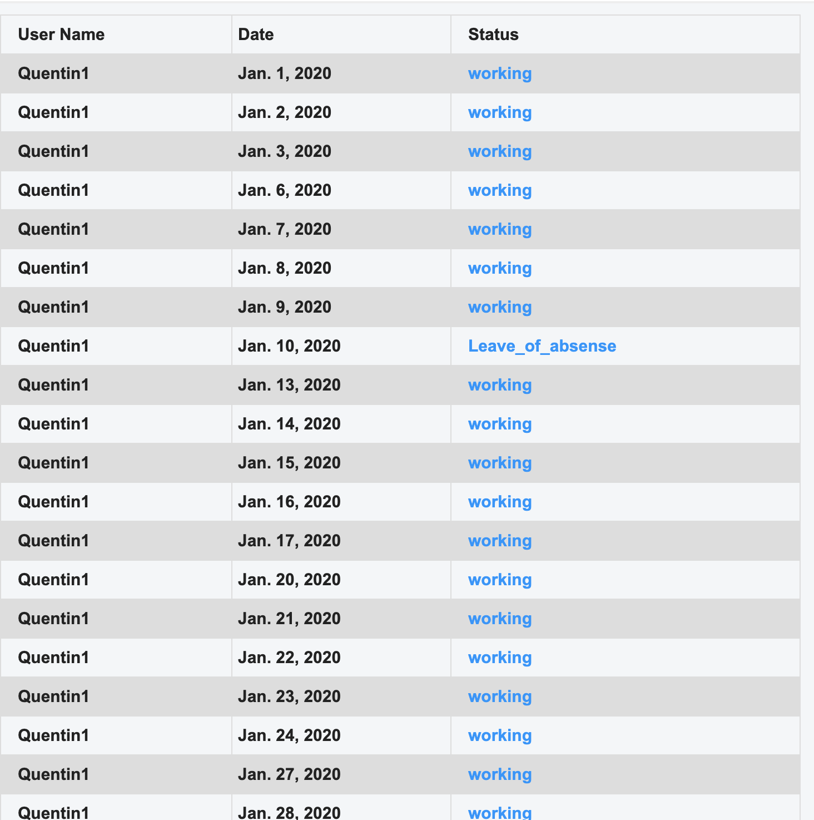
Monthly Timesheet Log
Employees will be able to monitor and track their past time sheet entries
Employee can plan his leaves for the future

Slide 12
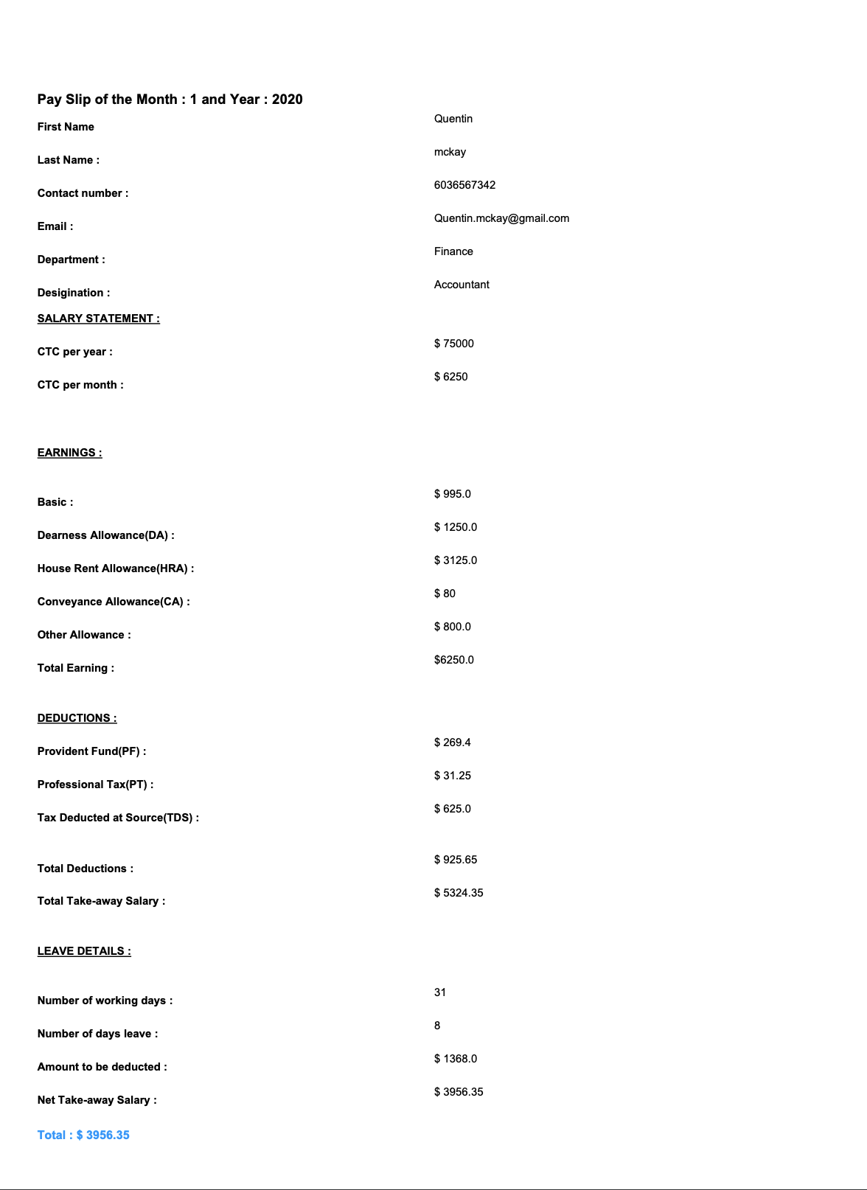
Pay-Slip PDF Template
Employees can download pay-slips from the application.
Pay-slips are auto-computed by considering the time sheets.

Slide 13
Deployment into AWS Elastic BeanStalk
Installation of AWSEBCLI, virtualENV, pip, Python 3.6
PIP freeze > requirements.txt – saves all the packages in txt file.
Create a directory named .ebextensions. Adding a configuration file WSGIPath, specifies the location of the WSGI script that Elastic Beanstalk uses to start your application.
Create an environment and deploy your application to it with eb create.
By adding CNAME in the allowed hosts in settings.py, then deploy the application again in the environment.

Slide 14
Components of AWS Elastic Beanstalk
Application : It refers to a unique label which is used as a deployable codes for a application.
Application Version : It resembles a folder which stores a collection of components such as environments versions and environment configuration.
Environment : Only the current version of the application runs.

Slide 15
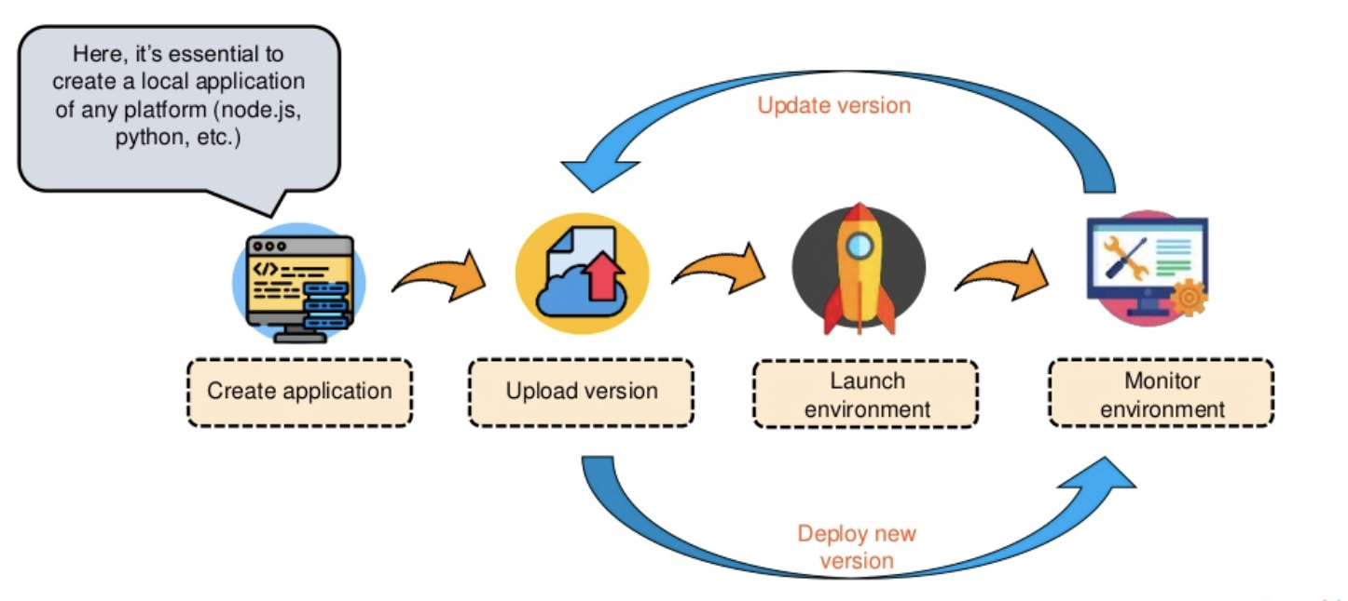

Slide 16
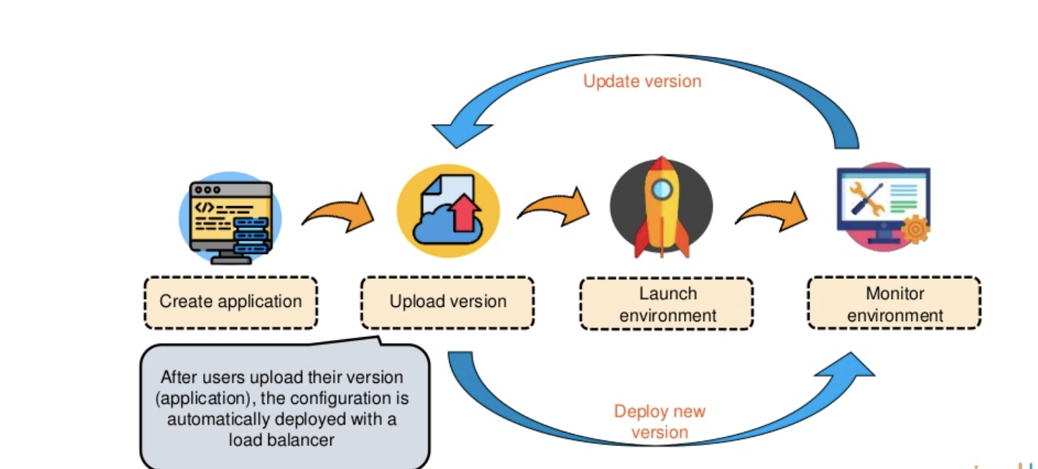

Slide 17
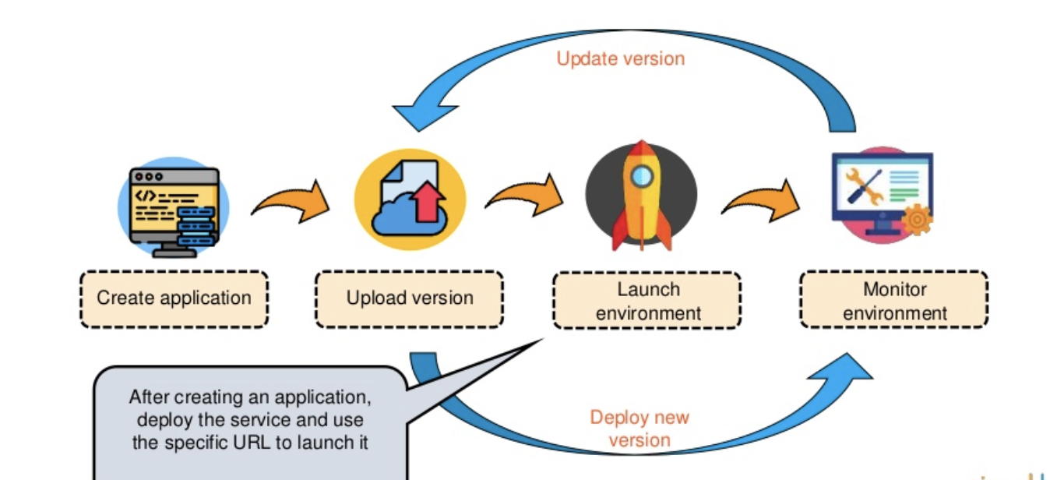

Slide 18
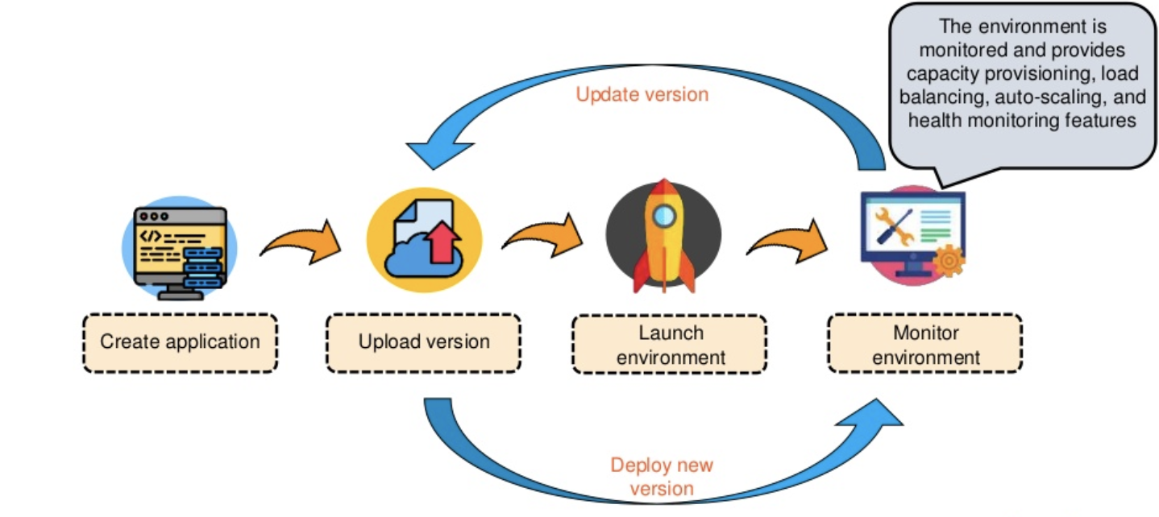

Slide 19
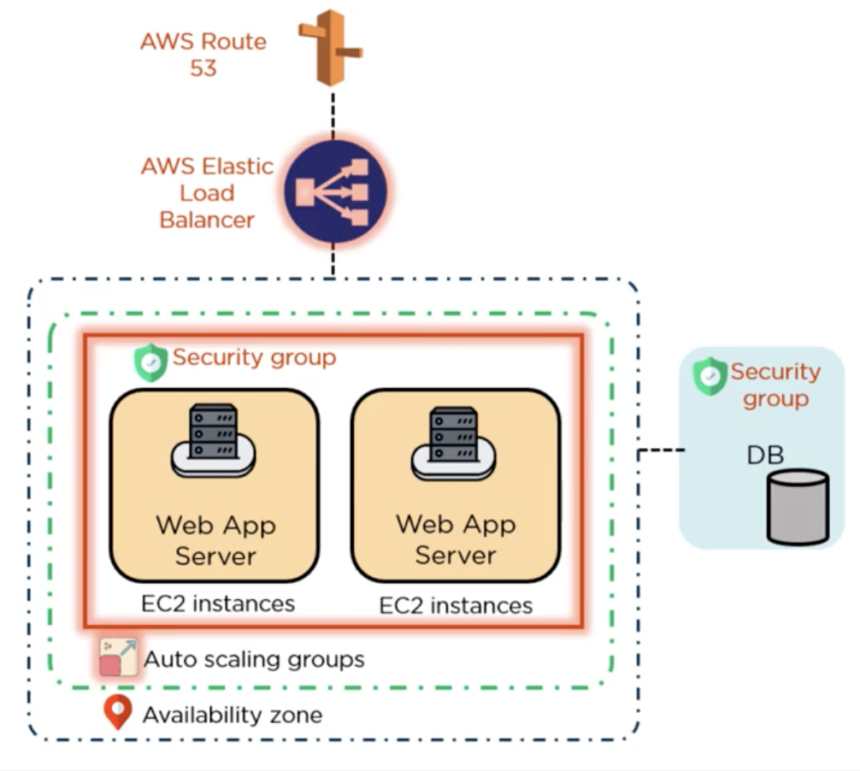
Architecture of AWS Elastic Beanstalk
If the application receives client requests amazon Route53 sends these requests to the AWS Elastic Load balancer.
It shares the requests among EC2 instances.
Every EC2 instances have a security group.

Slide 20
Architecture of AWS Elastic Beanstalk
The load balancer is connected to Amazon EC2 instances, which are part of an Auto scaling group.
Auto Scaling group automatically starts additional ec2 instances accommodate increasing load on application.
When load decreases, instances will also be decreased.
With these group, allows establishing security groups to the database server.

Slide 21
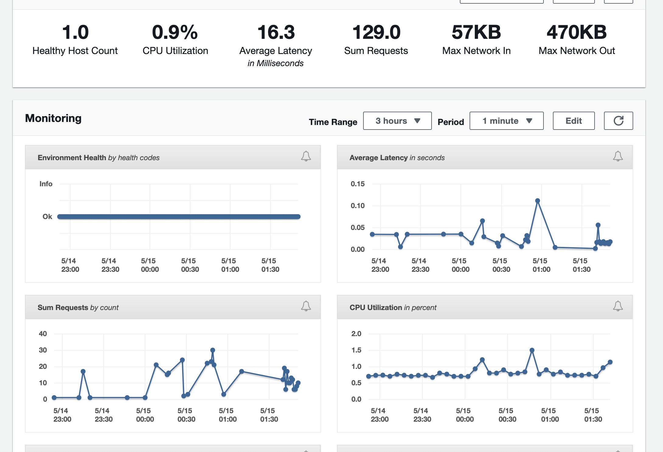
Monitoring
Amazon CloudWatch enables you to monitor, manage, and publish various metrics, as well as configure alarm actions based on data from metrics.
Amazon CloudWatch monitoring enables you to collect, analyze, and view system and application metrics so that you can make operational and business decisions more quickly and with greater confidence.

Slide 22
Results
The application provides Payroll Processing, Tax Filing, Year-end Reporting, Automatic Calculation Basic Pay, HRA.
The Beanstalk provides auto-scaling, the following group starts ec2 instances accommodate increasing load on application.
It provides load balancer and tools to monitor health of the application.

Slide 23
Future Development
Do java script client-side validations.
Make templates more interactive.

Slide 24
Conclusion
The proposed system was can help the small organizations to manage employee pay related data as personal information, salary information, Timesheet log Info.
It is integrated with AWS Elastic Beanstalk and provides a one-stop experience for you to manage the lifecycle of the application.
It has load balancer, Auto-scaling, Cloud watch, health monitoring. It supports the infrastructure to access globally.

Slide 25
Experience
Master’s project gave me the experience and exposure. The application used different products and software to get a task completed were I was able to get hands on experience with that software and technology.

Slide 26

ANY QUESTIONS

